Slide 1

2D Object Detection on nuImages
Simone Maravigna, Francesco Marotta

Slide 2
Content
Introduction
Dataset
Data Loader
Untrained Evaluation
Fine-Tuning
Evaluation and Results

Slide 3
Introduction
The goal of this project is to develop an object detection system for autonomous vehicles operating in urban environments using the nuImages dataset. To achieve this, we employed the Faster R-CNN model with a ResNet-50-FPN backbone, initialized with pretrained weights from the COCO dataset, and subsequently fine-tuned to recognize the 23 classes specific to the nuImages dataset. The code was implemented on Pytorch.

Slide 4
nuImages Dataset

Slide 5
nuImages Dataset
The nuImages dataset contains 93,000 labeled images captured by a total of six cameras, divided equally into 3 front cameras and 3 rear cameras.
Each image in the dataset is associated with a label that provides both semantic segmentation masks and 2D bounding boxes.
This dataset classifies 23 distinct classes for foreground objects (e.g ‘human.pedestrian.adult’, ‘movable_object.trafficcone’, ‘vehicle.car’, etc.)

Slide 6
Data Loader

Slide 7
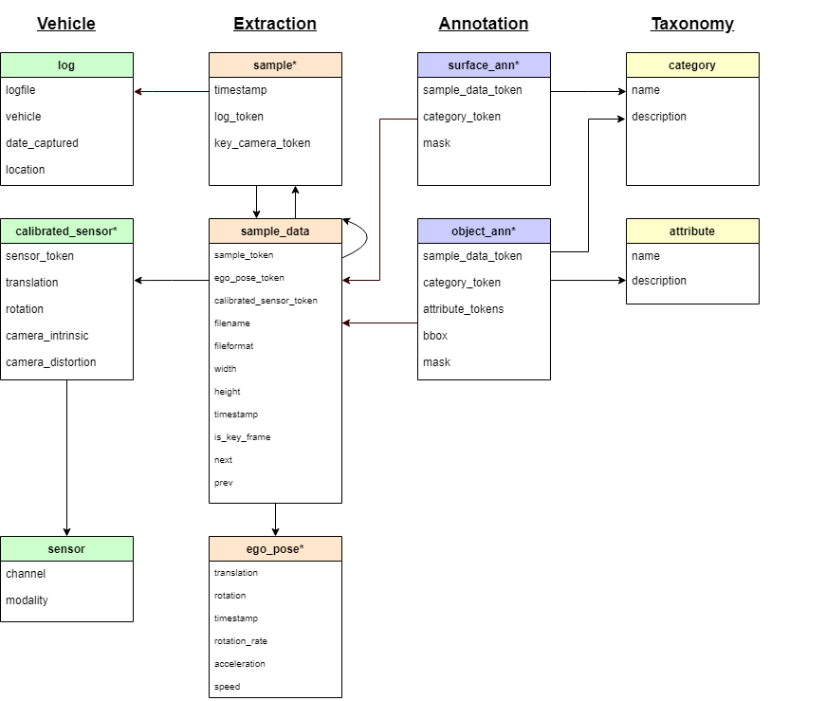
nuImages Schema

Slide 8
Data Loader
The data loader is able to navigate in such database to retrieve the image along with its corresponding annotations.
These annotations are composed of a tensor of shape [N, 4], which contains the bounding boxes, and a second tensor of shape [N], which contains the labels; where N is the number of objects in each image.

Slide 9
Untrained Evaluation

Slide 10
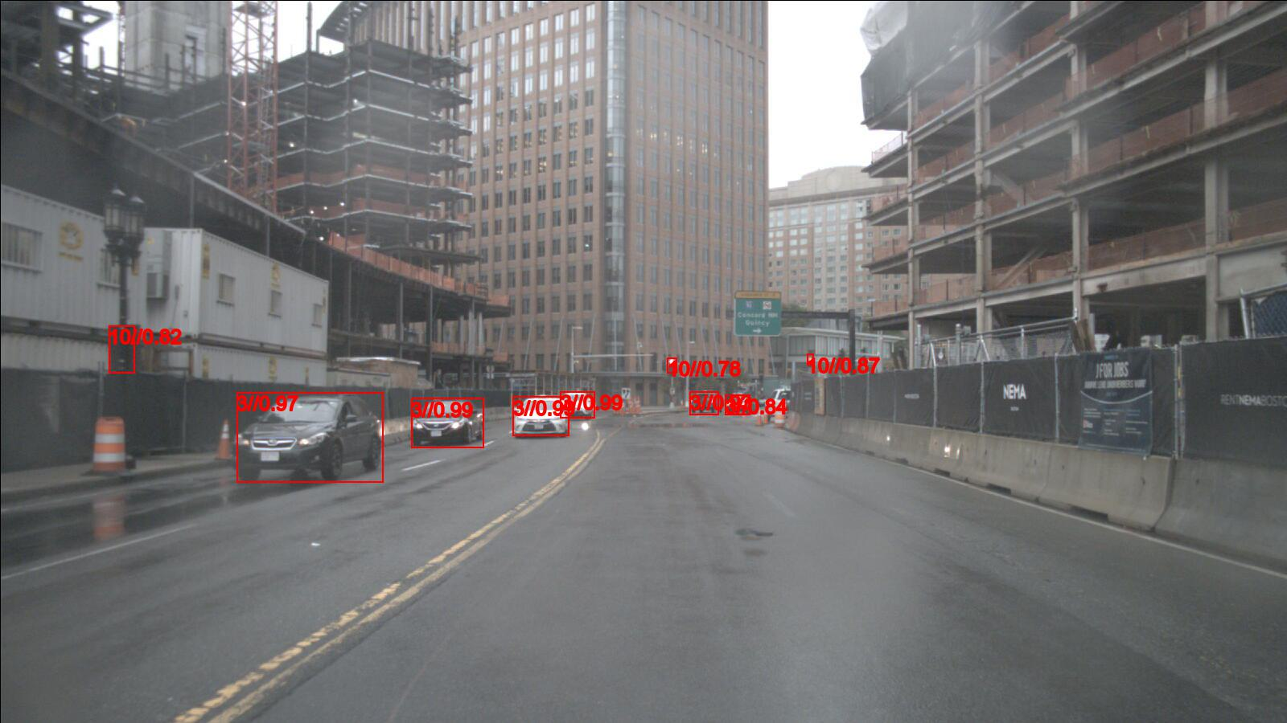
Untrained Evaluation
Several images from the nuImages dataset were input into the pre-trained model. The results indicated that the model successfully detected and accurately classified objects based on the COCO dataset labels (the model was pretrained on the COCO dataset).

Slide 11
Fine-Tuning

Slide 12
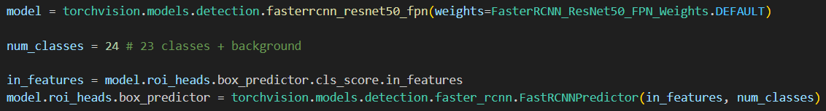

Fine-Tuning
The network was fine-tuned to adapt it to the dataset, and the box predictor layer was modified due to the dataset having fewer classes compared to COCO (24 vs 91).
Then, the model was trained for 10 epochs, using SGD as optimizer and using mean Average Precision as metric.

Slide 13
Evaluation and Results

Slide 14
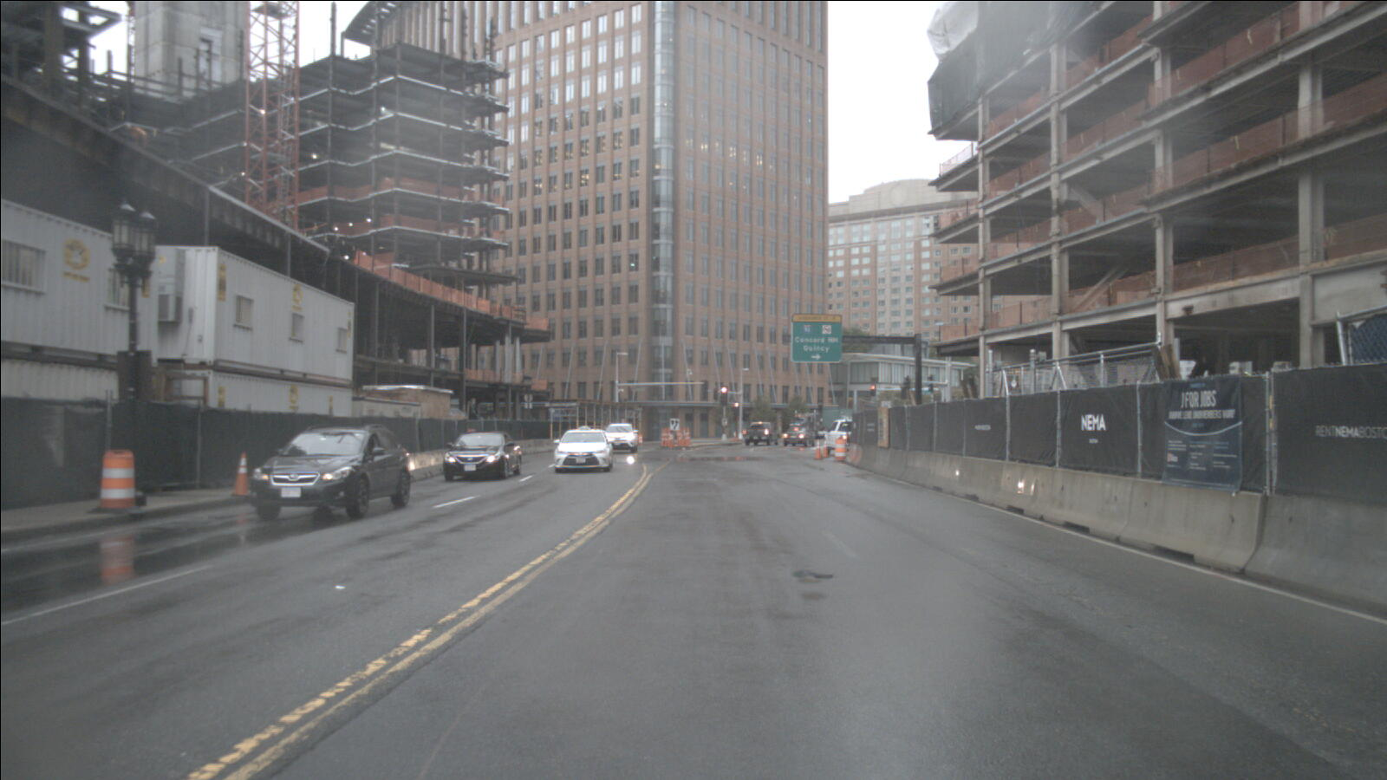
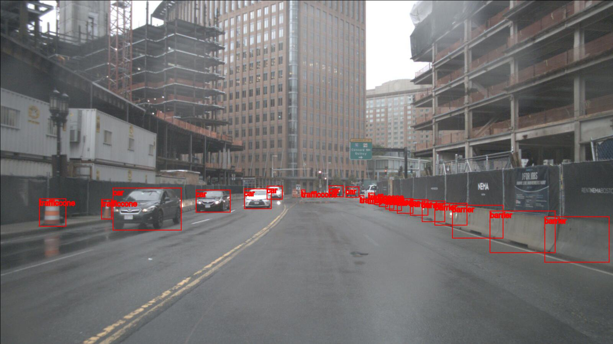
Evaluation and Results
After the 10 epochs, one cycle of evaluation was done, and gave as a result a mAP of around 48% on the validation dataset.

Slide 15
Difficulties and Take-Home Message

Slide 16
Difficulties
Take-Home Message
Understanding the complex dataset structure.
Dealing with multiple labels in one single image (also with no labels).
Dealing with object detection networks, such as Faster R-CNN, that requires multiple type of losses and multiple annotations in a single image.
Improving Pytorch skills.

Slide 17
Q&A

Slide 18
Thank you!

